Slide 1
Title Layout
Subtitle

Slide 2
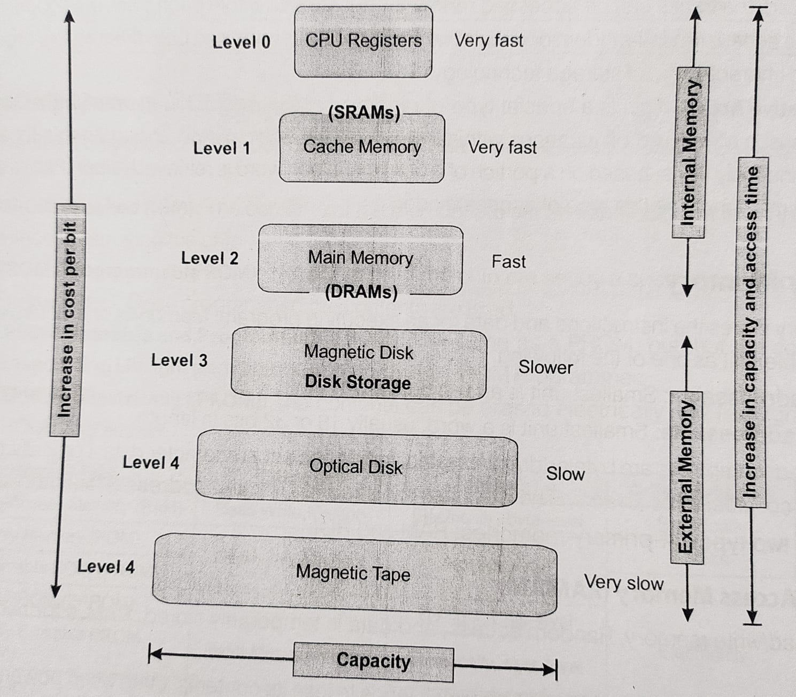
Memory Hierarchy Design

Slide 3
Types of Memory Access
Serial Access Memory:
The system must search the storage device from the beginning of the memory address until it finds the required piece of data.
Memory device which supports such access is called a sequential Access Memory or Serial Access Memory.
Example: Magnetic Tape
Direct Access Memory or Random Access memory:
System can go directly to the information that the user wants
Memory device which supports such access, called Direct Access memory
Example: Magnetic Disk and Optical Disks

Slide 4
Memory Access Methods
Sequential Access:
The access time in this type of memory depends on the location of the data.
Exp: Magnetic disks, magnetic tapes, optical memories (CD-ROM)
Random Access:
Semiconductor memories (RAM, ROM)
Direct Access:
Combination of previous two methods
The access time depends on the memory organization and the characteristic of storage technology
Associative Access:
This is a special type of random access

Slide 5
Primary Memory
Stores the instructions and data for an executing program.
Memory is characterized by the smallest addressable unit
Byte addressable: smallest unit is an 8-bit/Byte
Word addressable: Smallest unit is a word, usually 16 or 32 bits in length
Types of primary Memory:
RAM
ROM

Slide 6
RAM
DRAM: It tends to lose its contents, even when powered. Special “refresh circuitry” must be provided.
SDRAM (Synchronous DRAM)
Designed to work with a synchronous bus, one with a clock signal
The bus clock is driven by the CPU system clock
The memory transfers take place on a timing dictated by the memory bus clock rate
In Plain SDRAM, the transfers all take place on rising edges of the memory bus clock
In DDR SDRAM (Double Data Rate Synchronous DRAM), the transfers take place on both the rising and falling clock edges.
SRAM (Static RAM): It will keep its contents as log as it is powered.
SRAM is faster as compared to DRAM
More expensive
Physically larger

Slide 7
Comparison of DRAM and SRAM
 | DRAM | SRAM
Types of device | Analog | Digital
Electricity supply | Need | No Need
Speed | Slow | Fast
Construction | Simple | Complicated
Capacity | More | Less
Cost | Cheap | Costly
Application | Main memory | Cache memory

Slide 8
ROM (Read Only Memory, Random access, Data is permanently stored)
Classification:
MROsM (Masked ROM): the content of the memory are set at manufacture and cannot be changed without destroying the chip
PROM (Programmable ROM): The content are set by a special device called a “PROM Programmer”. Once programmed the contents are fixed.
EPROM (Erasable and Programmable ROM): same as PROM, but the contents can be erased using UV light and reprogrammed by the PROM Programmer
EEPROM (Electrically EPROM): Contents can be erased electrically and reprogrammed by the PROM Programmer.

Slide 9
Comarison
Memory Type | Category | Erasure | Write mechanism | Volatility
RAM | Read-Write Memory | Electrically, Byte-level | Electrically | Volatile
ROM | Read-Only Memory | Not Possible | Masks | Non-Volatile
PROM | Read-Only Memory | Not Possible | Electrically | Non-Volatile
EPROM | Read-Mostly Memory | UV light, chip level | Electrically | Non-Volatile
EEPROM | Read-Mostly Memory | Electrically, Byte level | Electrically | Non-Volatile
Flash memory | Read-Mostly Memory | Electrically, Block-level | Electrically | Non-Volatile

Slide 10
RAM Vs ROM
 | RAM | ROM
Accessibility | Easily accessible, directly communicate with the processor | The processor can’t directly access the information.
Volatility | Volatile | Non-Volatile
Storage | Temporary | Permanent
Speed | Faster | Slower
Data Preserving | Electricity supply is needed to flow the preserving information | Electricity supply is not needed
Structure | RAM is a Chip, inserted over the mother board | Optical drives, made of magnetic tapes
Cost | High | Low
Chip size | Larger than ROM | Smaller than RAM
Category | Read-Write Memory | Read Only

Slide 11
Memory Registers
MAR (Memory Address Register): It specifies the memory address of instruction or data item.
MBR (Memory Buffer Register): This holds the data read from memory or to be written to memory.
It is also called MDR (Memory Data Register)

Slide 12
Memory Control Signals
READ: Copy contents of an addressed word into the MBR
WRITE: Copy contents of the MBR into an addressed word
NOTHING: The memory expected to retain the contents written into it until those contents have been rewritten.

Slide 13
Characteristic of memory
Capacity:
Access Time: It’s the time interval between read/write request and the availability of the data.
Cycle time: Minimum time b/w two successive accesses
Throughput: The volume of information exchanged per unit of time (Unit: bits per second)
Non-volatility

Slide 14
Associative Memory
Also known as Content Addressable Memory (CAM) or Associative Storage or Associative Array
Optimized for performing searches through data
A hardware search engine, used in very high searching applications
Composed of semiconductor memory (usually SRAM) with added comparison circuitry that enable a search operation to complete in a single clock cycle.
It is widely used in database management systems

Slide 15
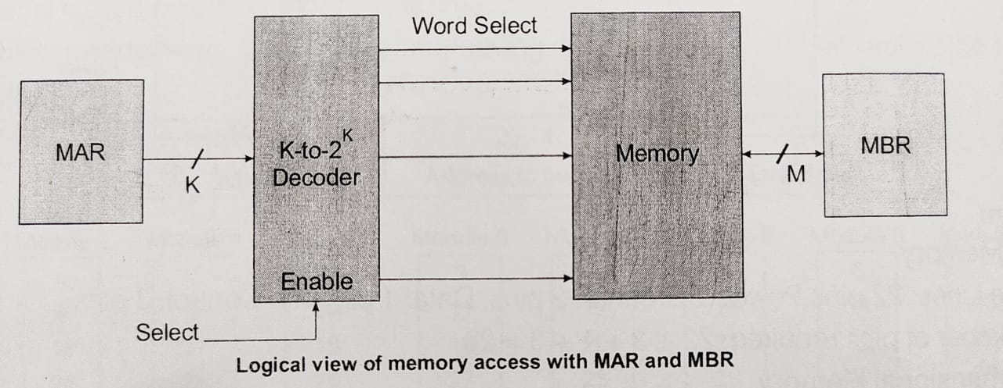
Address Space

Slide 16
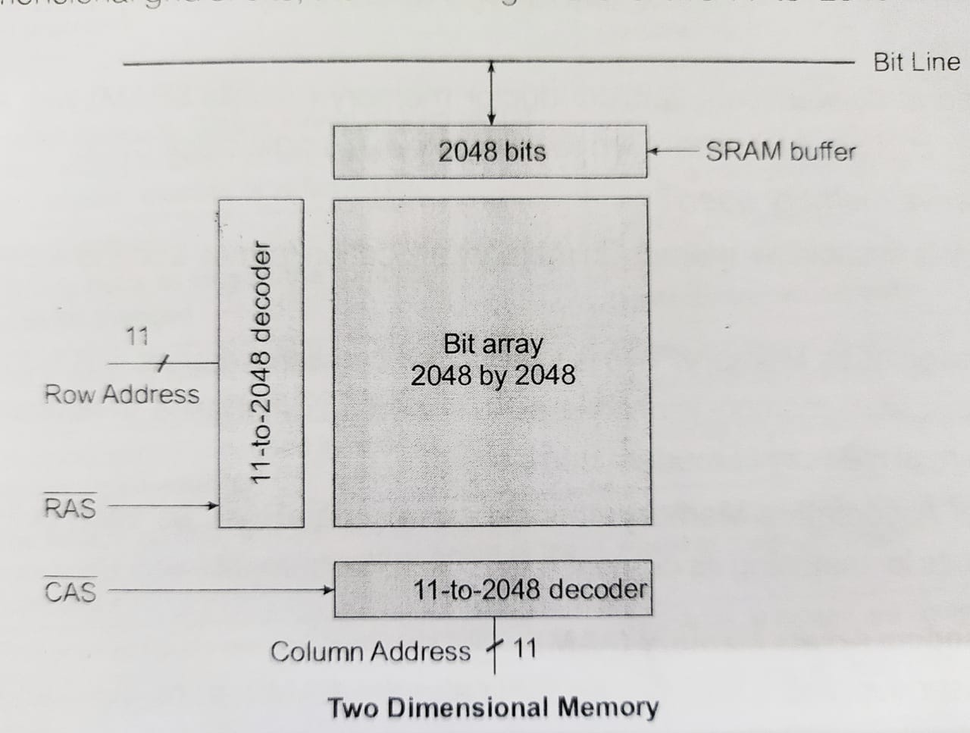
Memory Chip Organization
RAS signal is used for row address selection
CAS is used for column address selection

